Slide 1
Scientific Programming
Digital Image Processing
Image Enhancement
(Spatial Filtering)
Ankara University
Computer Engineering Department

Slide 2
Spatial Filtering
Filters are operators that are applied for image enhancement and enable certain operations to be performed in the image.
There are different filtering operators for different purposes.
Edge sharpening
Edge detection
Image smoothing
Noise removal can be given as filters examples.

Slide 3
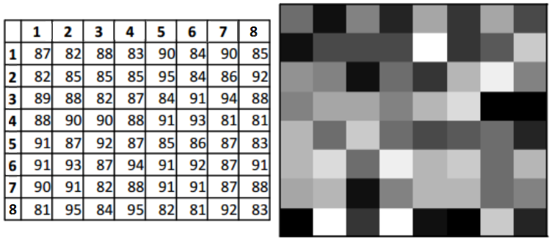
Spatial Filtering
The pixels that make up the image have the form of an matrix.
Matrix values contain the gray value of the pixel in related index.

Slide 4
Spatial Filtering
Masks/Filters are small (e.g. 3x3, 5x5, 7x7) 2D arrays which contain values that determine the process.
Origin
x
Filters are neighbourhood operations.
Filters are mostly a rectangle around a central pixel.
Any size rectangle filter is possible.
(x, y)
Neighbourhood
y
Image f (x, y)

Slide 5
Simple Neighbourhood Operations
Some simple neighbourhood operations include:
Min: Set the pixel value to the minimum in the neighbourhood
Max: Set the pixel value to the maximum in the neighbourhood
Median: The median value of a set of numbers is the midpoint value in that set (e.g. from the set [1, 7, 15, 18, 24] 15 is the median).

Slide 6
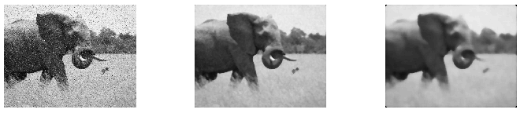
Median Filter - MATLAB
im=imread('median.png');
im=rgb2gray(im);
result1=medfilt2(im,[7,7]);
result2=medfilt2(im,[15,15]);
figure;
subplot(1,3,1); imshow(uint8(im));
subplot(1,3,2); imshow(uint8(result1));
subplot(1,3,3); imshow(uint8(result2));

Slide 7
The Spatial Filtering Process
Origin
x
a
b
c
r
s
t
d
e
f
*
u
v
w
g
h
i
x
y
z
Original Image Pixels
Filter
Simple 3*3 Neighbourhood
e
3*3 Filter
e_{processed} = v*e + r*a + s*b + t*c + u*d + w*f + x*g + y*h + z*i
y
Image f (x, y)
The above is repeated for every pixel in the original image to generate the filtered image.

Slide 8
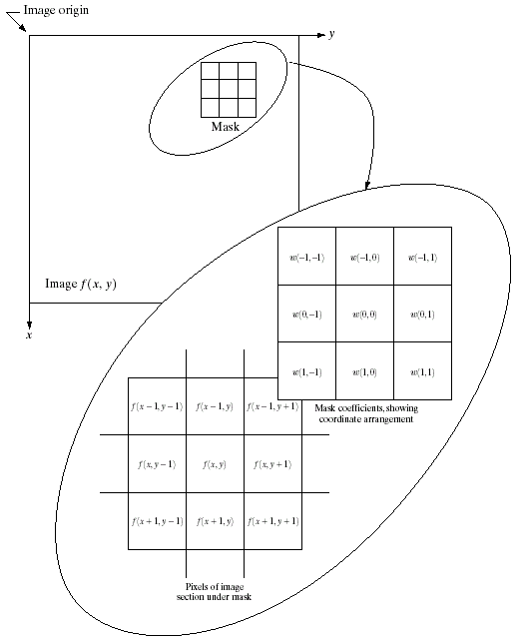
Spatial Filtering: Equation Form
Filtering can be given in equation form as shown above
Notations are based on the image shown to the left

Slide 9
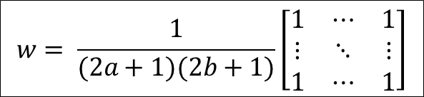
Smoothing Spatial Filters
One of the simplest spatial filtering operations we can perform is a smoothing operation
Simply average all of the pixels in a neighbourhood around a central value
Especially useful in removing noise from images
Also useful for highlighting gross detail
$$w= \frac{1}{(2a+1)(2b+1)}\left[\begin{matrix}1 & ⋯ & 1 \\ ⋮ & ⋱ & ⋮ \\ 1 & ⋯ & 1\end{matrix}\right]$$

Slide 10
Smoothing Spatial Filtering
Origin
x
104
100
108
¹/₉
¹/₉
¹/₉
99
106
98
*
¹/₉
¹/₉
¹/₉
95
90
85
¹/₉
¹/₉
¹/₉
Original Image Pixels
Filter
¹/₉
¹/₉
¹/₉
Simple 3*3 Neighbourhood
104
100
108
3*3 Smoothing Filter
¹/₉
¹/₉
¹/₉
99
106
98
¹/₉
¹/₉
¹/₉
95
90
85
e = ¹/₉*106 + ¹/₉*104 + ¹/₉*100 + ¹/₉*108 + ¹/₉*99 + ¹/₉*98 + ¹/₉*95 + ¹/₉*90 + ¹/₉*85
= 98.3333
y
Image f (x, y)
The above is repeated for every pixel in the original image to generate the smoothed image

Slide 11
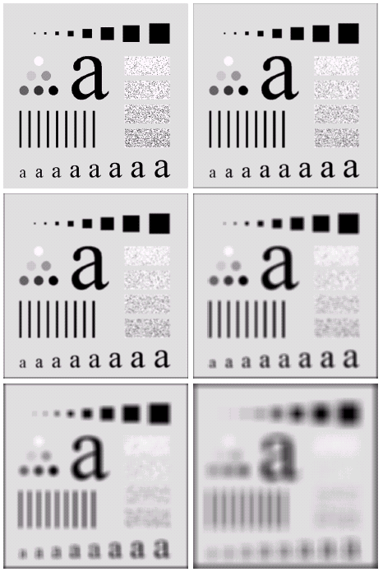
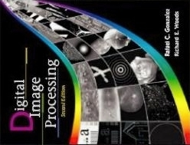
Image Smoothing Example
The image at the top left is an original image of size 500*500 pixels
The subsequent images show the image after filtering with an averaging filter of increasing sizes
3, 5, 9, 15 and 35
Notice how detail begins to disappear
Images taken from Gonzalez & Woods, Digital Image Processing (2002)

Slide 12
Weighted Smoothing Filters
More effective smoothing filters can be generated by allowing different pixels in the neighbourhood different weights in the averaging function
Pixels closer to the central pixel are more important
Often referred to as a weighted averaging
¹/₁₆ | ²/₁₆ | ¹/₁₆
²/₁₆ | ⁴/₁₆ | ²/₁₆
¹/₁₆ | ²/₁₆ | ¹/₁₆
Weighted averaging filter

Slide 13
Averaging Filter – MATLAB
im = imread('average.png');
result1 = imfilter(im, ones(3,3)/9);
result2 = imfilter(im, ones(9,9)/81);
result3 = imfilter(im, ones(35,35)/1225);
figure;
subplot(2,2,1); imshow(uint8(im));
subplot(2,2,2); imshow(uint8(result1));
subplot(2,2,3); imshow(uint8(result2));
subplot(2,2,4); imshow(uint8(result3));

Slide 14
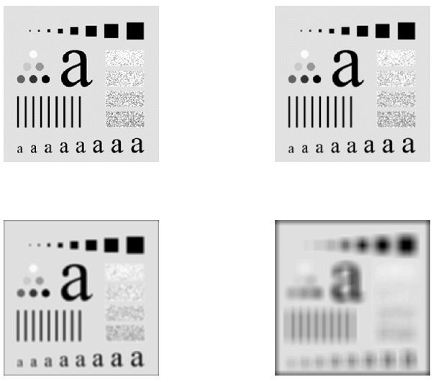
Averaging Filter – MATLAB

Slide 15
Strange Things Happen At The Edges!
At the edges of an image we are missing pixels to form a neighbourhood
Origin
x
e
e
e
e
e
e
e
y
Image f (x, y)

Slide 16
Strange Things Happen At The Edges! (cont…)
There are a few approaches to dealing with missing edge pixels:
Omit missing pixels
Only works with some filters
Can add extra code and slow down processing
Pad the image
Typically with either all white or all black pixels
Replicate border pixels
Truncate the image
Allow pixels wrap around the image
Can cause some strange image artefacts

Slide 17
MATLAB
B = imfilter(A, h, options,...)
Padding Options
numeric scalar, X | Input array values outside the bounds of the array are assigned the value X. When no padding option is specified, the default is 0.
'symmetric' | Input array values outside the bounds of the array are computed by mirror-reflecting the array across the array border.
'replicate' | Input array values outside the bounds of the array are assumed to equal the nearest array border value.
'circular' | Input array values outside the bounds of the array are computed by implicitly assuming the input array is periodic.
Output Size
'same' | The output array is the same size as the input array. This is the default behavior when no output size options are specified.
'full' | The output array is the full filtered result, and so is larger than the input array.

Slide 18
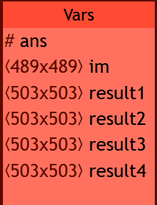
MATLAB
im = imread('average.png');
result1 = imfilter(im, ones(15,15)/225, 'full');
result2 = imfilter(im, ones(15,15)/225, 'symmetric', 'full');
result3 = imfilter(im, ones(15,15)/225, 'replicate', 'full');
result4 = imfilter(im, ones(15,15)/225, 'circular', 'full');
figure;
subplot(2,2,1); imshow(uint8(result1));
subplot(2,2,2); imshow(uint8(result2));
subplot(2,2,3); imshow(uint8(result3));
subplot(2,2,4); imshow(uint8(result4));

Slide 19
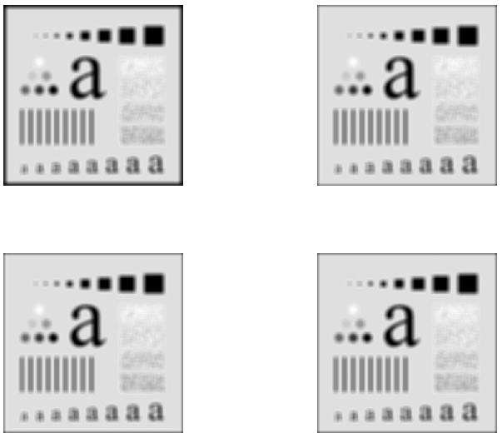
Strange Things Happen At The Edges! (cont…)

Slide 20
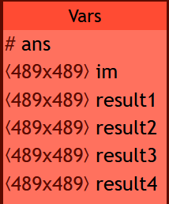
MATLAB
im = imread('average.png');
result1 = imfilter(im, ones(15,15)/225);
result2 = imfilter(im, ones(15,15)/225, 'symmetric');
result3 = imfilter(im, ones(15,15)/225, 'replicate');
result4 = imfilter(im, ones(15,15)/225, 'circular');
figure;
subplot(2,2,1); imshow(uint8(result1));
subplot(2,2,2); imshow(uint8(result2));
subplot(2,2,3); imshow(uint8(result3));
subplot(2,2,4); imshow(uint8(result4));

Slide 21
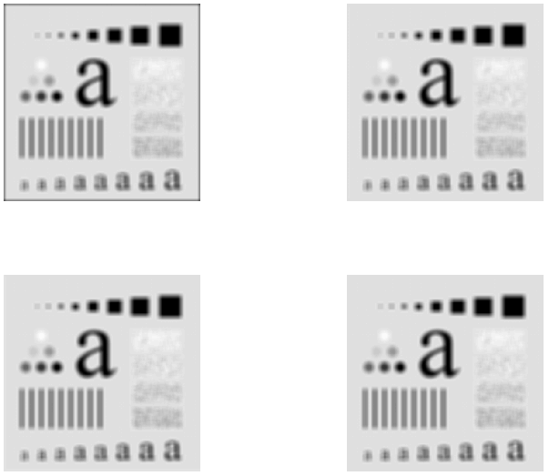
Strange Things Happen At The Edges! (cont…)

Slide 22
Sharpening Spatial Filters
Previously we have looked at smoothing filters which remove fine detail
Sharpening spatial filters seek to highlight fine detail
Remove blurring from images
Highlight edges
Sharpening filters are based on spatial differentiation
Differentiation measures the rate of change of a function.

Slide 23
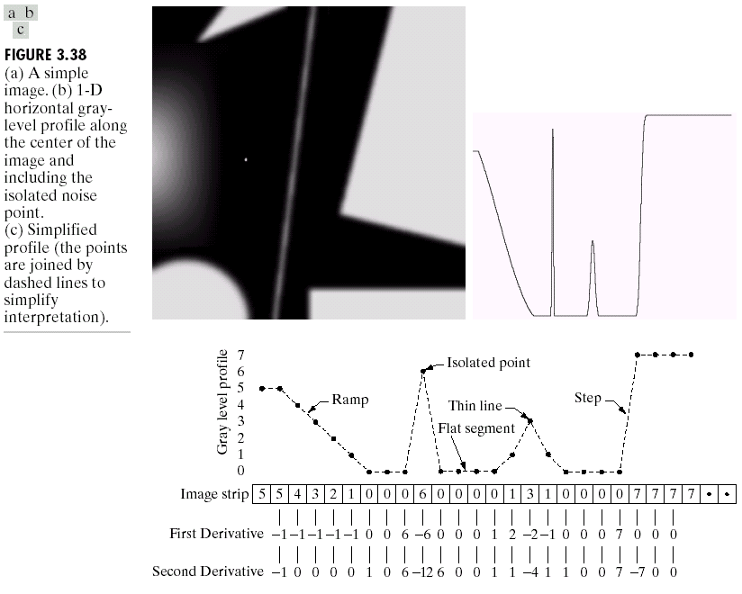
Spatial Differentiation
A
B
Images taken from Gonzalez & Woods, Digital Image Processing (2002)

Slide 24
1st Derivative
The formula for the 1st derivative of a function is as follows:
It’s just the difference between subsequent values and measures the rate of change of the function.

Slide 25
1st Derivative (cont…)
5 | 5 | 4 | 3 | 2 | 1 | 0 | 0 | 0 | 6 | 0 | 0 | 0 | 0 | 1 | 3 | 1 | 0 | 0 | 0 | 0 | 7 | 7 | 7 | 7
 | 0 | -1 | -1 | -1 | -1 | 0 | 0 | 6 | -6 | 0 | 0 | 0 | 1 | 2 | -2 | -1 | 0 | 0 | 0 | 7 | 0 | 0 | 0

Slide 26
2nd Derivative
The formula for the 2nd derivative of a function is as follows:
Simply takes into account the values both before and after the current value

Slide 27
2nd Derivative (cont…)
5 | 5 | 4 | 3 | 2 | 1 | 0 | 0 | 0 | 6 | 0 | 0 | 0 | 0 | 1 | 3 | 1 | 0 | 0 | 0 | 0 | 7 | 7 | 7 | 7
 | -1 | 0 | 0 | 0 | 0 | 1 | 0 | 6 | -12 | 6 | 0 | 0 | 1 | 1 | -4 | 1 | 1 | 0 | 0 | 7 | -7 | 0 | 0

Slide 28
Using Second Derivatives For Image Enhancement
The 2nd derivative is more useful for image enhancement than the 1st derivative
Stronger response to fine detail
The first sharpening filter we will look at is the Laplacian
Isotropic
One of the simplest sharpening filters
We will look at a digital implementation

Slide 29
The Laplacian
The Laplacian is defined as follows:
where the partial 2nd order derivative in the x direction is defined as follows:
and in the y direction as follows:

Slide 30
The Laplacian (cont…)
So, the Laplacian can be given as follows:
We can easily build a filter based on this
0
1
0
1
-4
1
0
1
0

Slide 31
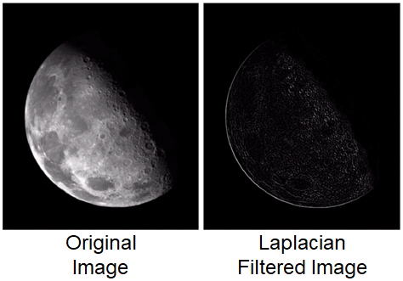
The Laplacian (cont…)
The result of a Laplacian filtering is not an enhanced image
Applying the Laplacian to an image we get a new image that highlights edges and other discontinuities
Subtract the Laplacian result from the original image to generate our final sharpened enhanced image.
Images taken from Gonzalez & Woods, Digital Image Processing (2002)

Slide 32
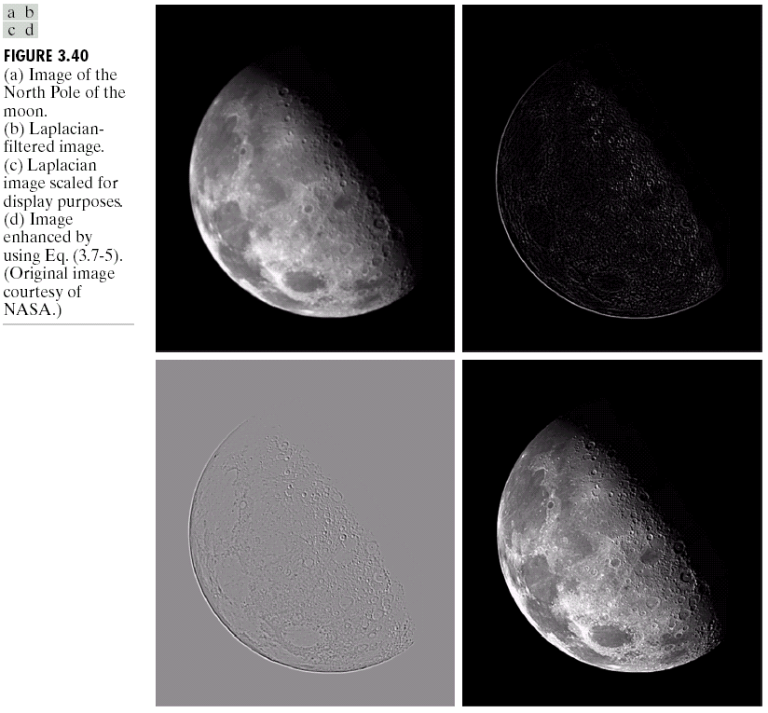
Laplacian Image Enhancement
-
=
Original Image
Laplacian Filtered Image
Sharpened Image
Images taken from Gonzalez & Woods, Digital Image Processing (2002)
In the final sharpened image edges and fine detail are much more obvious

Slide 33
Simplified Image Enhancement
The entire enhancement can be combined into a single filtering operation

Slide 34
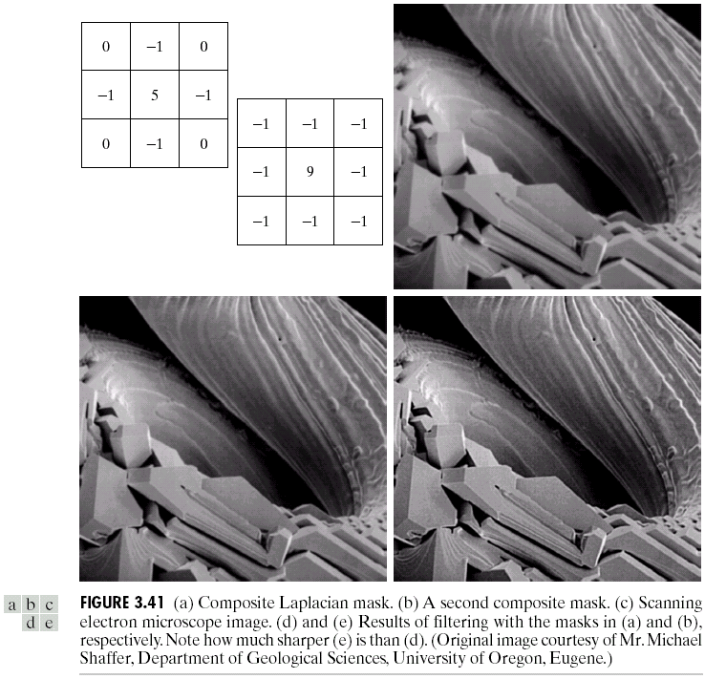
Simplified Image Enhancement (cont…)
This gives us a new filter which does the whole job for us in one step
Images taken from Gonzalez & Woods, Digital Image Processing (2002)
0
-1
0
-1
5
-1
0
-1
0

Slide 35
Variants On The Simple Laplacian
There are lots of slightly different versions of the Laplacian that can be used:
0
1
0
1
1
1
Simple Laplacian
Variant of Laplacian
1
-4
1
1
-8
1
0
1
0
1
1
1
Images taken from Gonzalez & Woods, Digital Image Processing (2002)
-1
-1
-1
-1
9
-1
-1
-1
-1

Slide 36
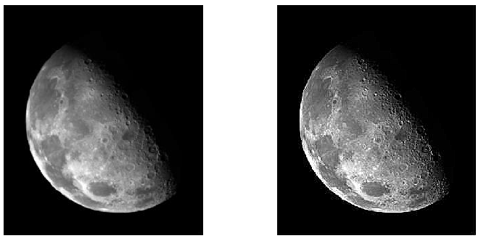
Filters - MATLAB
im=imread('moon.png');
filt=[0, -1, 0; -1, 5, -1; 0,-1,0]
result=imfilter(im,filt);
figure;
subplot(1,2,1); imshow(uint8(im));
subplot(1,2,2); imshow(uint8(result));

Slide 37
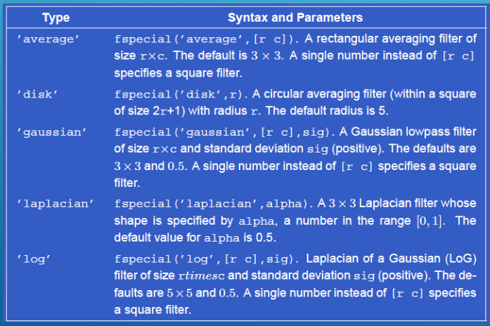
Filters - MATLAB
F = fspecial(‘type’, parameters)

Slide 38
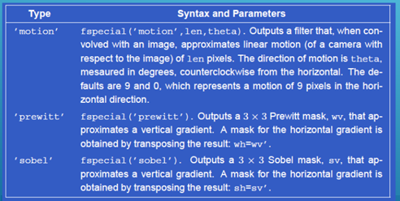
Filters - MATLAB
F = fspecial(‘type’, parameters)

Slide 39
Filters - MATLAB
im=imread('edge.png');
l=fspecial('laplacian', 0);
lap=imfilter(im, l);
s1=fspecial('sobel');
s2=s1';
s3=s1+s2;
sob1=imfilter(im, s1);
sob2=imfilter(im, s2);
sob3=imfilter(im, s3);
p1=fspecial('prewitt');
p2=p1';
p3=p1+p2;
pre1=imfilter(im, p1);
pre2=imfilter(im, p2);
pre3=imfilter(im, p3);
figure;
subplot(2,4,1); imshow(im); title('original');
subplot(2,4,2); imshow(sob1); title('Sobel 1');
subplot(2,4,3); imshow(sob2); title('Sobel 2');
subplot(2,4,4); imshow(sob3); title('Sobel 3');
subplot(2,4,5); imshow(lap); title('Laplacian');
subplot(2,4,6); imshow(pre1); title('Prewitt 1');
subplot(2,4,7); imshow(pre2); title('Prewitt 2');
subplot(2,4,8); imshow(pre3); title('Prewitt 3');

Slide 40
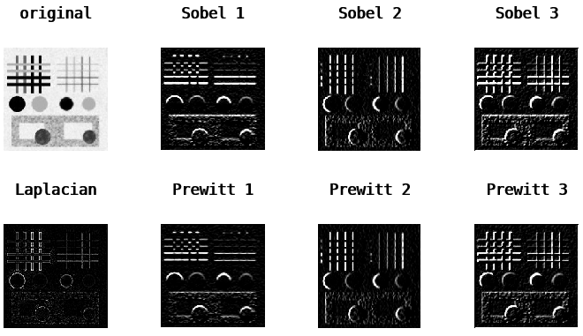
Filters - MATLAB

